Slide 1
DEX3 BUSINESS MODEL
Innovative/ startup products strategy partners are preferred.
Decentralized Marketplace Infrastructure is everything.
Not a marketplace, but everything; powered by GRIDZ Token.
Users/ Customers/ Owners are One and the same.
Affiliate/ Digital marketing are the tools to procure
Users > Customers > Contributors > Owners.

Slide 2
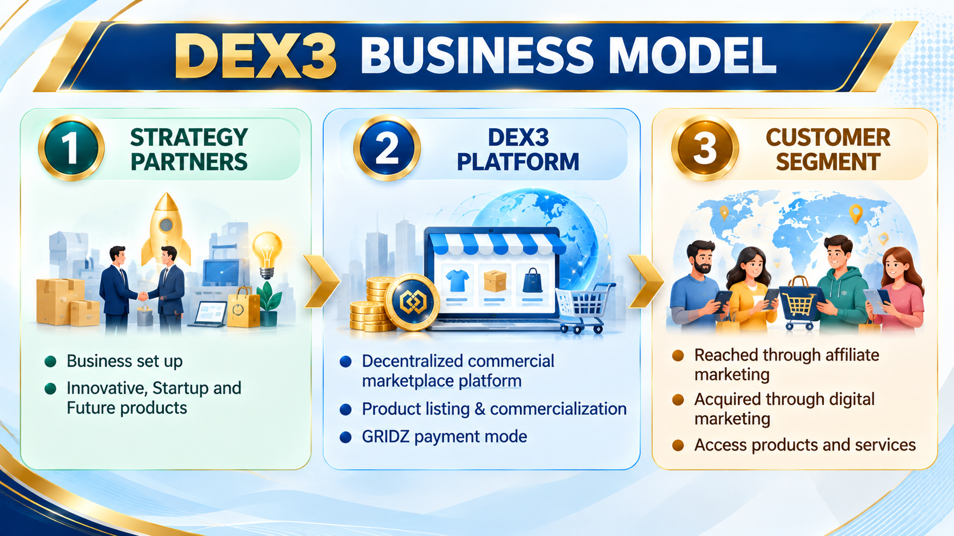

Slide 3
TECHNICAL SUPPORT
Digital Product Transformation
NFT/ RWA Token Development
Discovering smart/ future/ easy products.
Conversion of present products into a futuristic transformation.
Example: Amazon, Swiggy, Ola, OYO
Real World Asset Tokens, the next business model for Real Estate/ Construction/ Stocks/ Jewellery etc.
Non Fungible Tokens do the above for arts and virtual assets.

Slide 4
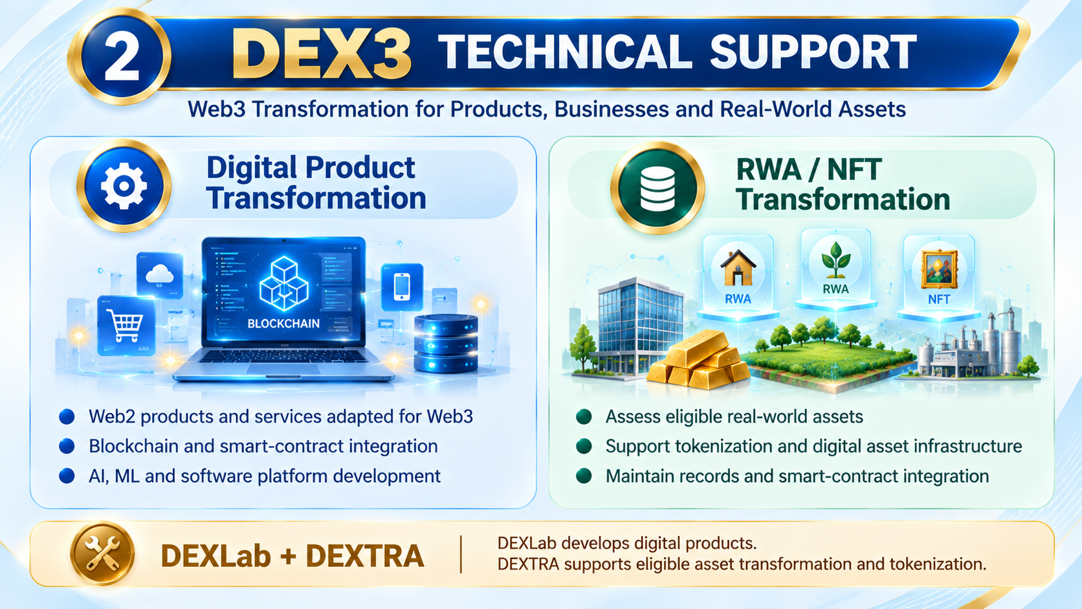

Slide 5
FUNDING SUPPORT
GRIDZ Token, Cryptocurrency function as a everlasting Capital Resource for DEX3 needs.
25% tokens are sold/ staked allocated to the Production unit.

Slide 6
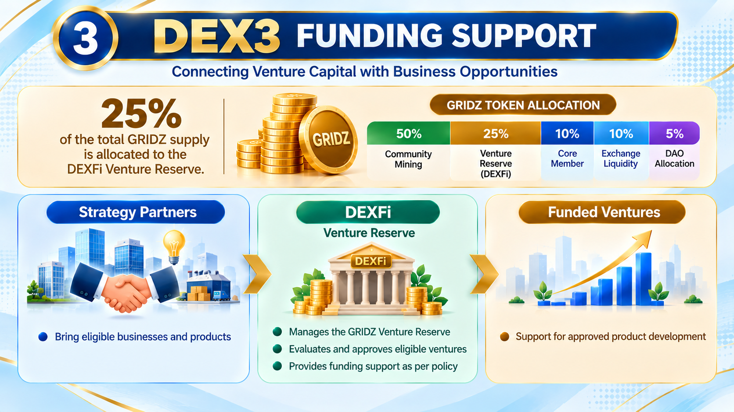

Slide 7
DECENTRALIZED OWNERSHIP
Become an User/ Customer initially,
Contribute if you can with respect to Capital, Network mainly.
Gain Grid Contribution Points (GCP) for every contribution.
The contribution (PoC), the Human Value, is one form of Mining.
Proof of Contribution mines GCP, that decides ownership value.
According to the monthly value, profit would be shared.
System does everything, paid via GRIDZ/USDT, that’s decentralization.

Slide 8
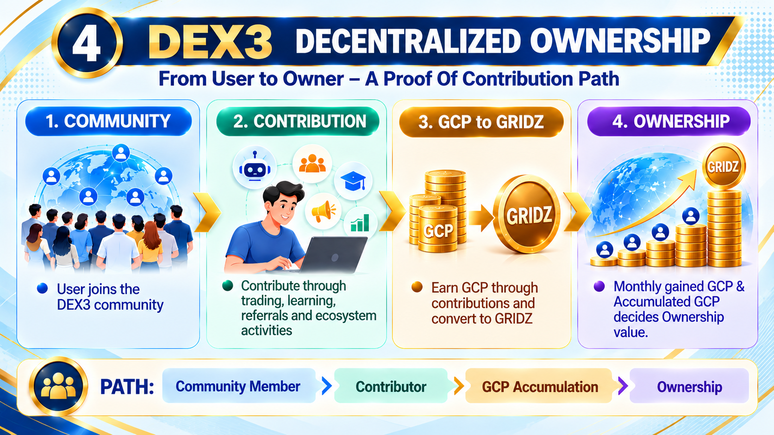

Slide 9
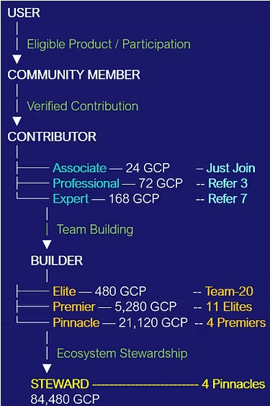
REWARDS & INCOME MODEL
Rank | Qualification GCP | Partner-structure | Maximum Share
Associate | 24 | Contributor entry rank | -
Professional | 72 | Higher Contributor qualification | -
Expert | 168 | Advanced Contributor qualification | -
Elite Partner | 480 | Maximum 3 Elites per line | 10 Elite
Premier Partner | 5,280 | 11 Elite shares as the reference for one Premier | 3 Premier
Pinnacle Partner | 21,120 | 4 Premier shares as the reference for one Pinnacle | 3 Pinnacle
Steward | 84,480 | 4 Pinnacle shares as the reference for Steward | Unlimited

Slide 10
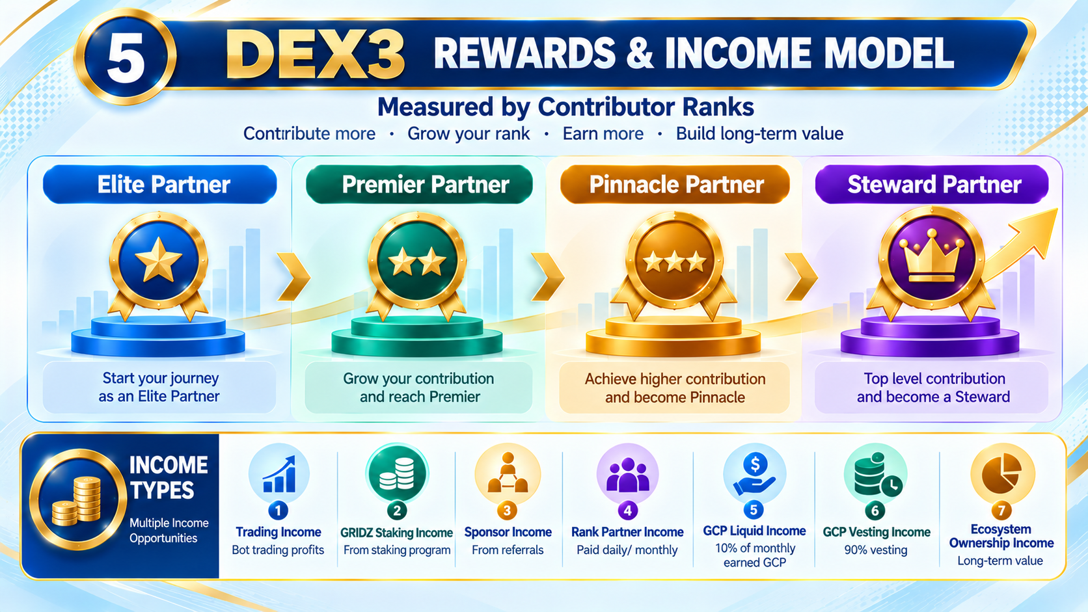

Slide 11
UNITS
Unit | Main function
DEXLab | Develops digital products, software, AI/ML, blockchain and Web3 applications.
DEXFi | Proposed venture reserve, treasury and financial-resource layer.
DEXPO | Launchpad and commercialisation platform for products and ventures.
DEXTRA | Digital Asset Transformation and tokenisation infrastructure for eligible assets.
DEXDOT | Proposed asset-specific digital instruments for eligible real-world and selected digital assets.
DEXChange | Marketplace or exchange layer for eligible digital and tokenised assets, subject to applicable law.
QDX Academy | Education and capability development, including trading education and after-study support.

Slide 12
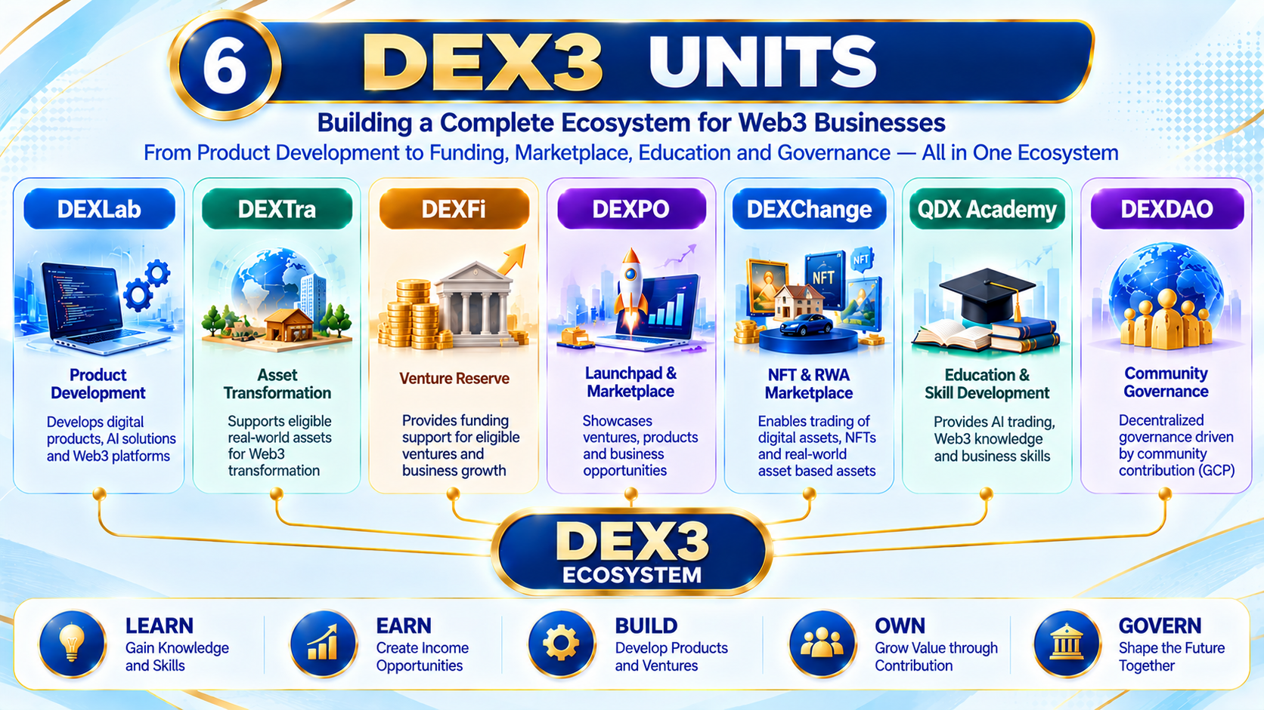

Slide 13
PRODUCTS
Product | Working price reference | Purpose
GRIDX Trading Bot | 99 USDT lifetime; 33 USDT monthly | AI-assisted trading product.
GRIDZ | 99 USDT per lot reference | Proposed ecosystem token.
QDX education | 99 USDT full-course | Trading education and after-study support.
DEXDOT | 99 USDT per unit reference; (coming soon) | Proposed asset-specific digital instruments for eligible asset use cases.

Slide 14
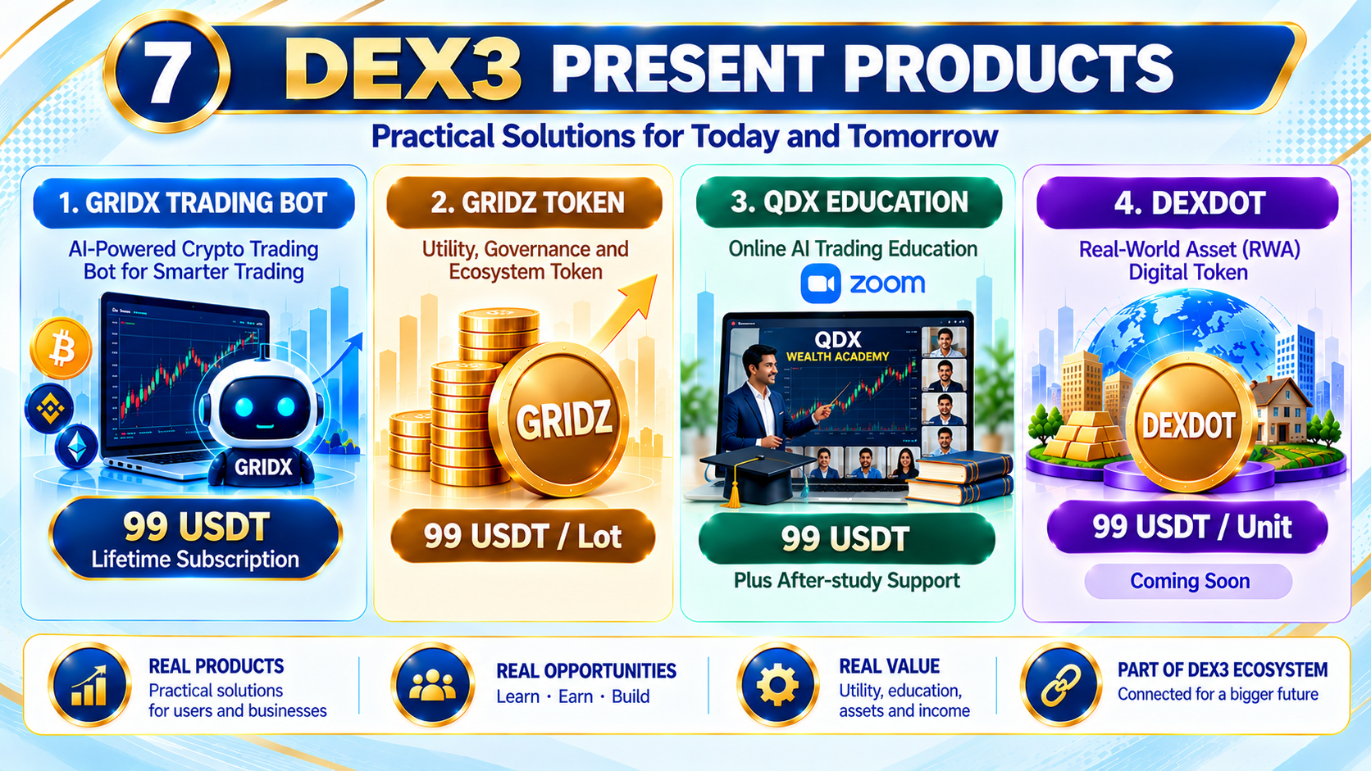

Slide 15
GLOBAL REACH
Channel | Main contribution
Affiliate network | Personal referrals, community reach, partner introductions and product discovery.
SEO — Search Engine Optimisation | Improves discoverability through relevant search results over time.
SMO/SMM — Social Media Optimisation and Marketing | Builds awareness and engagement through social platforms.
Webinars and demonstrations | Explain product functions and support informed evaluation.
Combined marketing | Supports customer acquisition and Strategy Partner outreach.

Slide 16


Slide 17
COST STRUCTURE
Capital layer | Proposed purpose
₹43 lakh foundation target | GRIDZ, PoC/GCP, UI/UX, landing page, marketing, dashboards, legal, technical and security groundwork.
₹1.16 crore subsequent layer | Further digital and software infrastructure after the foundation stage.
Yet not frozen | Broader technology, ventures, tokenisation, marketplace, governance and expansion.

Slide 18
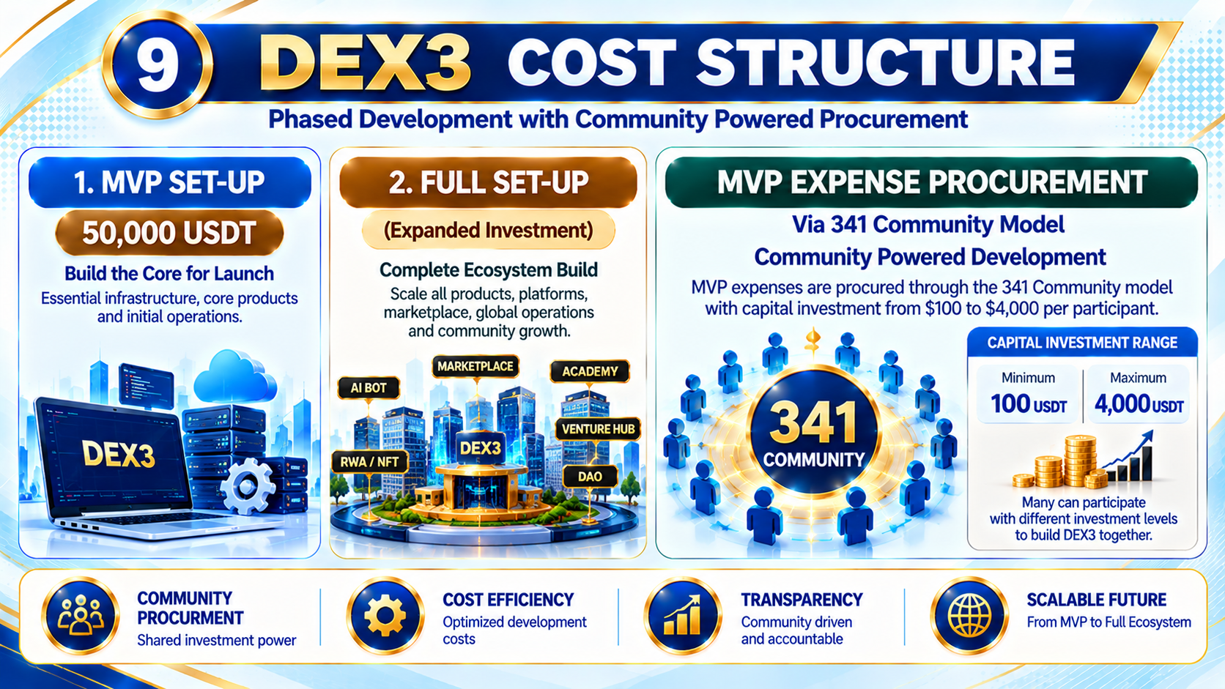

Slide 19
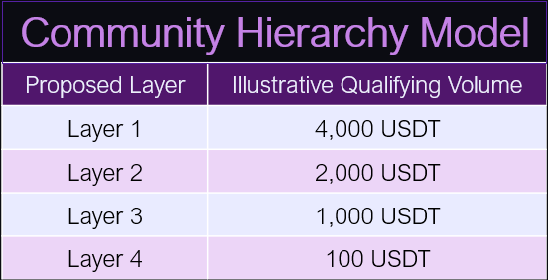
COMMUNITY TO OWNERSHIP
Placement factors and slot changes should be governed by published rules covering:
Verified joining time and qualifying capital.
Personal referral contribution and other approved factors.
Tie-breaking procedures.
Payment verification, cancellations and refunds.
Appeals and permitted changes to positions.

Slide 20
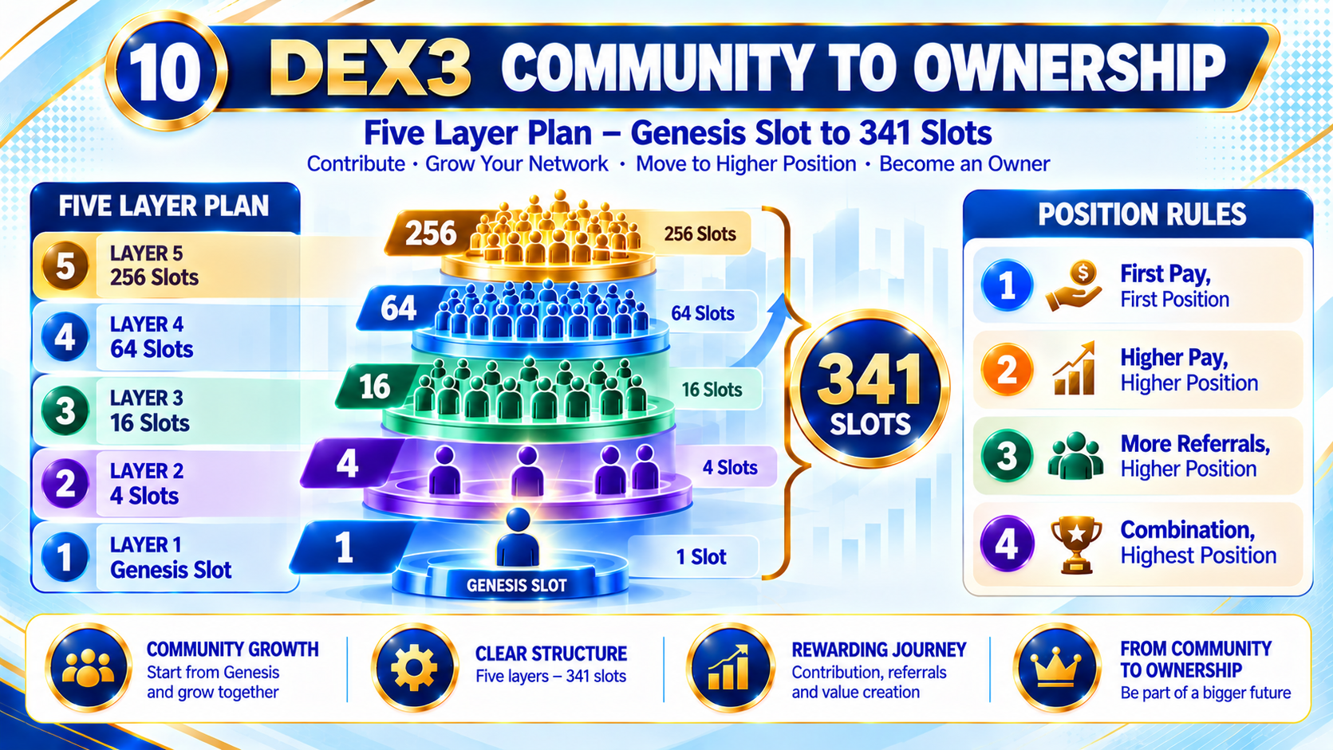

Slide 21
ROADMAP
Target date | Proposed milestone
2 November 2026 | MVP work and outreach start
16 November 2026 | SEO, SMO and digital marketing target start
30 November 2026 | Landing page and videos targeted
15 December 2026 | GRIDZ V2 readiness/launch target
31 December 2026 | Initial 341-member formation target
31 January 2027 | Phase One MVP completion target
1 February 2027 | Business launch target

Slide 22
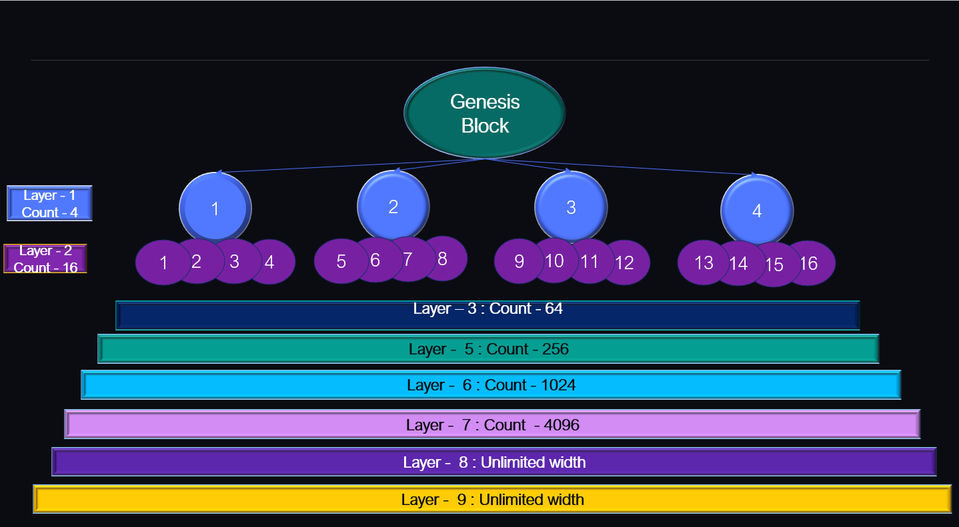

Slide 23
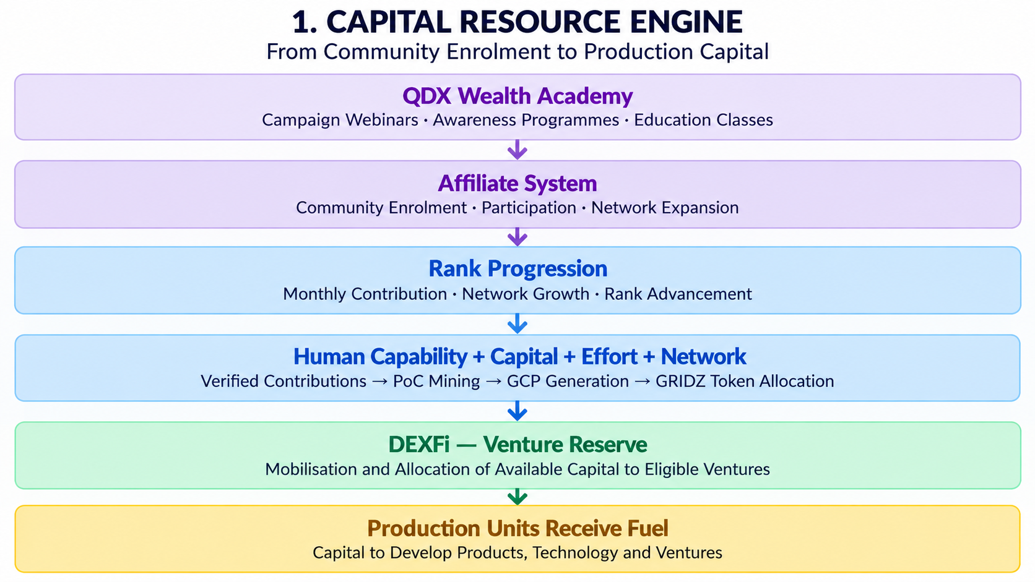

Slide 24
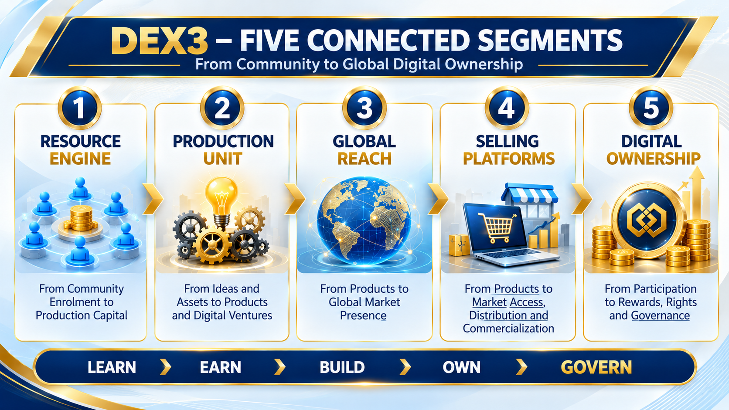

Slide 25
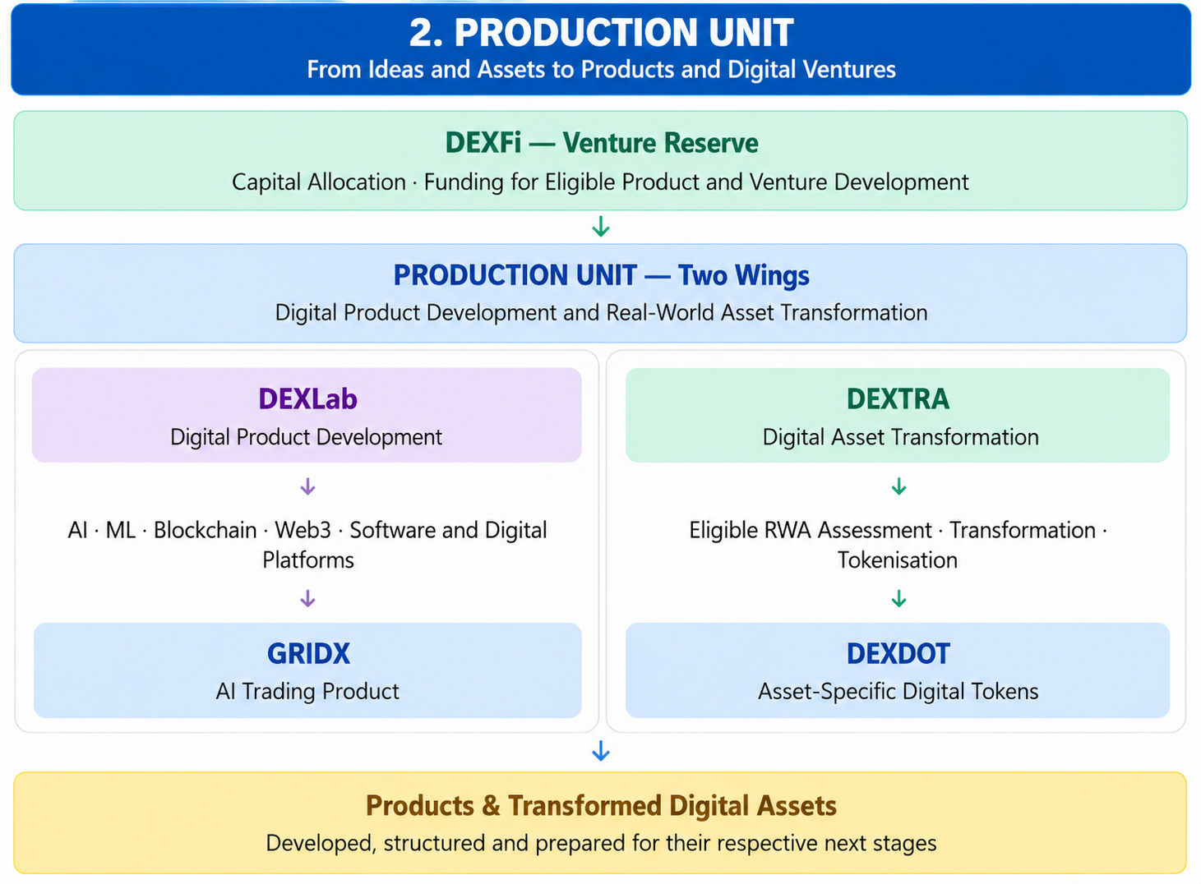

Slide 26
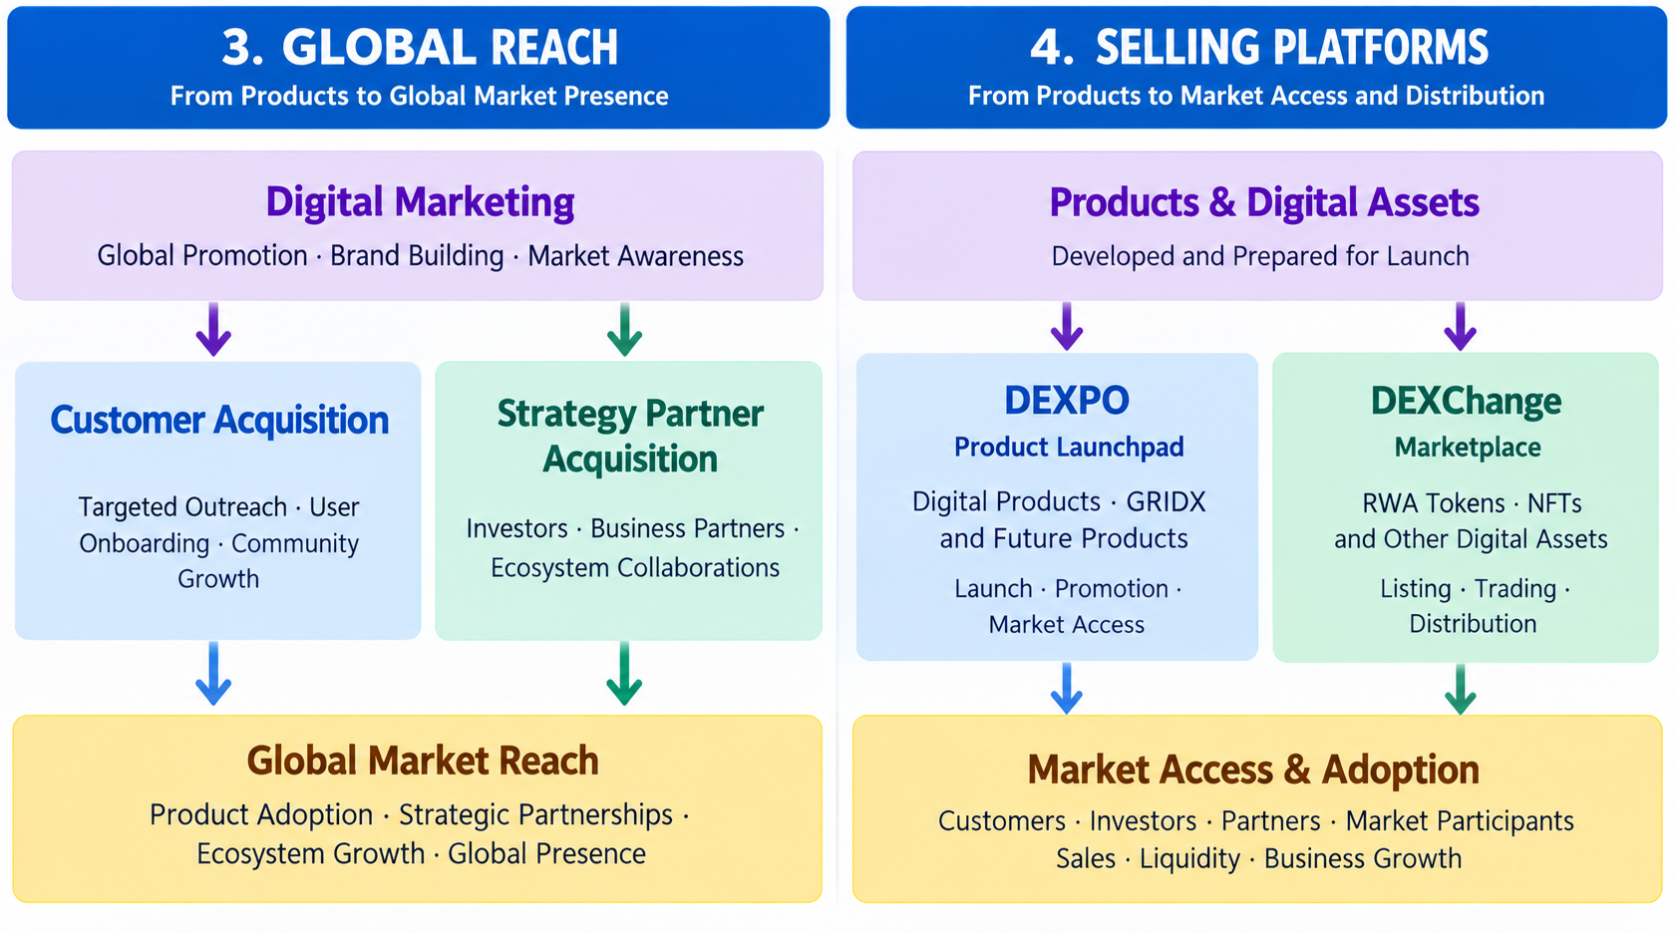

Slide 27
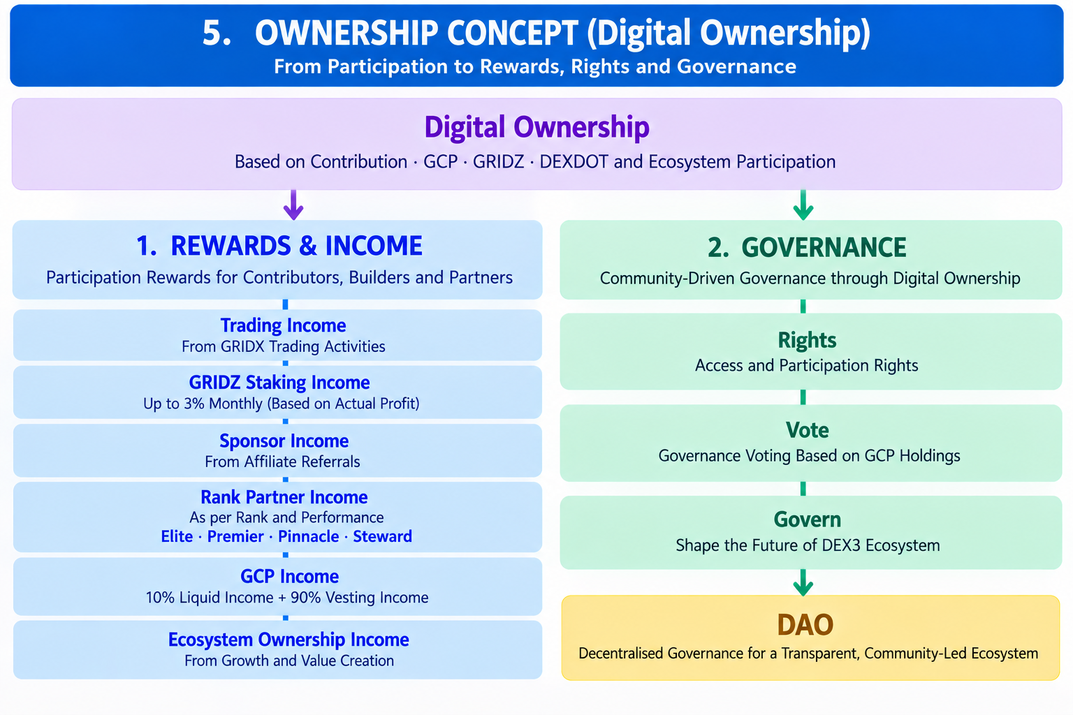

Slide 28
