Slide 1
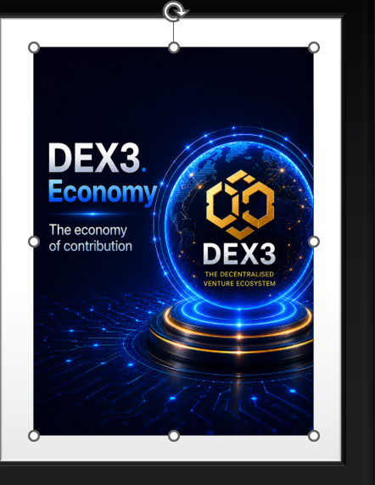
DEX3: Constitutional Decentralized Business Ecosystem

Slide 2
DEX3
OPPORTUNITY
What DEX3 Can: What you have ; The Result if both unites

Slide 3

Components of
Opportunity
Ownership
Technology
Community
Resource
Global Reach
Affiliate System
Infrastructure
Platform

Slide 4
DEX3: Parts & Processes
Sl.No | SUBJECT | DESCRIPTION
1 | Contribution 100% Decentralized | $100 or more; Fully/Partially/Zero Participation
2 | Technology Innovate & Transform | Web3/ Blockchain (+ AI & Machine Learning)
3 | Community Limited time offer | Capital Contributors (Founding Owners Forum)
4 | Resource Unlimited Capital Reserve | Cryptocurrency: Proof of Contribution Mining
Sl. No | SUBJECT | DESCRIPTION
5 | Global Reach (DEX3 Role) | Digital Marketing: SEO, SEM SMO, SMM
6 | Affiliate Marketing (DEX3 Owners Role) | Refer : Manual/ Digital path User To Contributor To Owner
7 | Infrastructure - Built Digitally | Software: Build, Process, Govern, Own
8 | Platform - Commercialization | Strategy Partners/ Products / Customers/ Marketplace
What DEX3 Can

Slide 5
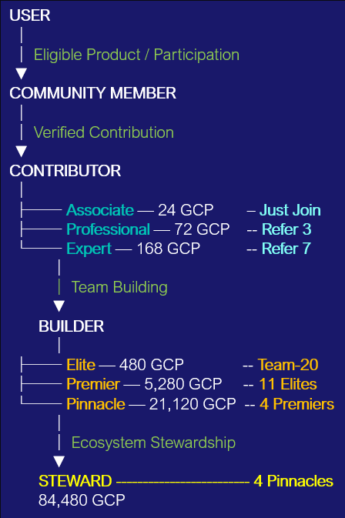

Your Participation
Human Capability is the Capital
Participation | Primary | Secondary | Investment
Zero | Nil | Nil | $ 100
Partial | Participation | Referral Contribution | $ 100
Fully | Become Elite Rank | Become Steward Rank | $ 4000 or above
What You Have
The Result if both unites

Slide 6
PART-I
TECHNOLOGY
The Digital Construction

Slide 7

The Story of Human Progress
The human need existed first;
technology reorganized how it could be fulfilled
A powerful technology can create
an entirely new economic architecture
around existing human needs.

Slide 8




A paradigm shift, the WEB3
Feature | Web 1.0 | Web 2.0 | Web 3.0
Concept | Read only | Read + Write | Read + Write + Own
Period | 1990 - 2000 | 2000 - Present | 2010- still developing
User role | Reader | Creator and participant | Owner and participant
Governance | Website owner | Platform operator | Community-based governance
Architecture | Mostly static websites | Centralized Platform with Cloud services | Decentralized systems with Conventional infrastructure
Transactions | Traditional payments | Digital payments | Cryptocurrency and smart contracts
Examples | Yahoo, Netscape, AOL, GeoCities | Meta, YouTube, Google, Amazon | Bitcoin, Ethereum, Solana, Uniswap
Decentralized digital money
Smart-contract platform
Blockchain infrastructure
Decentralized exchange protocol

Slide 9
WEB 2.O CONTEXT
CONCERN | PURPOSE | REQUIREMENTS
Ola/Uber | Mobility | Smartphone + GPS + Software
OYO | Hospitality | Internet + Mobile + digital distribution
Paytm | Payments | Transaction + Mobile + digital infrastructure
Swiggy/Zomato | Food | Mobile + logistics + digital infrastructure
Zepto | Retails | Digital infrastructure + fulfilment + logistics
Netflix | Entertainment | Internet + Streaming + Content Platform

Slide 10
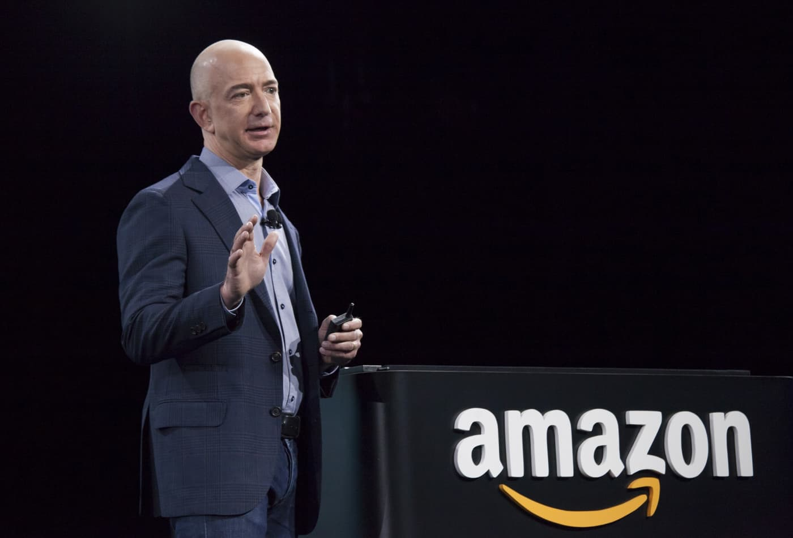
Technology & Marketplace
INTERNET
↓
Global Connectivity
↓
Vendors + Marketplace + Customers + Technology + Logistics
↓
Global Commerce

Slide 11
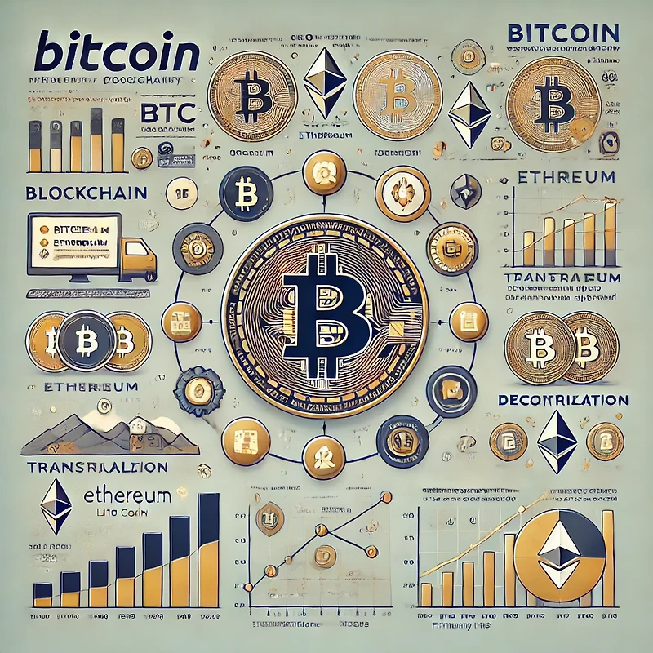
A decentralized Accounting Network
Period | Happenings
1980s–1990s | Researchers developed concepts for digital cash and cryptographic money.
1997 | Adam Back developed Hash-cash, a Proof-of-Work concept applied.
1998 | Wei Dai proposed b-money; Nick Szabo developed the Bit Gold.
2007 | Satoshi Nakamoto reportedly began developing Bitcoin's design/code.
Aug 2008 | bitcoin.org was registered.
31 Oct 2008 | Satoshi published Whitepaper ( A Peer-to-Peer Electronic Cash System”)
3 Jan 2009 | Genesis Block (Block 0) was mined; birth of the Bitcoin.
9 Jan 2009 | Bitcoin v0.1 software was released publicly and mining began.
12 Jan 2009 | Satoshi sent 10 BTC to Hal Finney — the first Bitcoin transaction
2009–2010 | Bitcoin was mainly an experimental, small community network.
22 May 2010 | 10,000 BTC for 2 pizzas. Laszlo Hanyecz - Payer; Jeremy Sturdivant - Payee
2010s | Exchanges, wallets, businesses, institutional interest developed.
2012 | First Bitcoin halving: 50 → 25 BTC per block.
2024 onward | U.S. spot Bitcoin ETFs were approved in January 2024.

Slide 12
PART-II
PLATFORM
Decentralized Marketplace

Slide 13
WEB2:
Centralized Platform
WEB3:
Decentralized Platform
Service
Providers
Centralized
Platform
Customer
Base
Strategy Partners
Decentralized Platform
Users/
Customers
But,
Contributors

Slide 14
PART-III
CONSTRUCTION
Total Digital Infrastructure

Slide 15
DEX3 Ecosystem Architecture
DEXLab
BUILD
DEXFi
FUND
DEXPO
LAUNCH
DEXTRA
TOKENIZE
DEXDOT
RWA/NFT REPRESENTATION
DEXChange
MARKET
QDX Academy
EDUCATE
GRIDX
PIONEER PRODUCT
GRIDZ
ECONOMIC INFRASTRUCTURE
DEXDAO
GOVERN

Slide 16
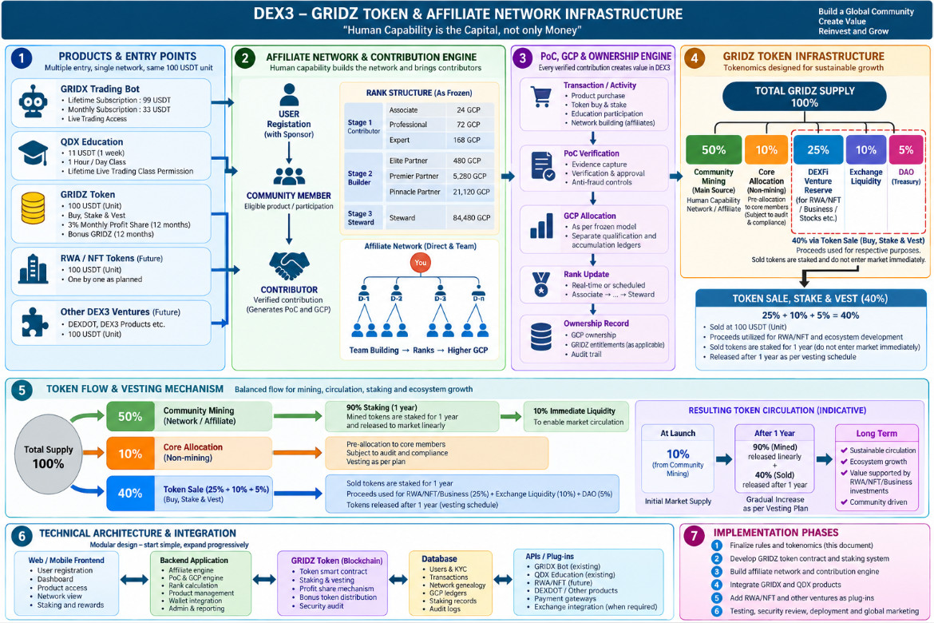

Slide 17
PART-IV
RESOURCE
GRIDZ: Proof of Contribution Mining

Slide 18
GRIDZ: the unlimited resources
Building the Foundation of a Constitutional Decentralised Business Ecosystem
GRIDZ Token
Proof of Contribution (PoC)
Affiliate Network
Primary Community Formation

Slide 19

PoC —
Proof of Contribution
HUMAN CAPABILITY
↓
CONTRIBUTION
↓
VERIFICATION
↓
GCP
↓
GRIDZ
↓
REWARDS & OWNERSHIP

Slide 20

Capital Core Contributors Illustration
ELEMENT | DESCRIPTION
Capital Contribution | Rs 34 Lac
GRIDZ Allocation | Proposed 10 × qualifying capital reference
Staking Period | 12 months
Vesting Period | 24 Months
Lock-Period Profit Share | Proposed up to 3% monthly for 12 months
Vesting Bonus | Applicable approved bonus GRIDZ
Governance Rights | Proposed 1/10 of Core reference
Profit Participation Rights | Proposed 1/10 of Core reference
This Photo by Unknown Author is licensed under CC BY-SA

Slide 21
PART-V
CONTRIBUTION
What do you have matters

Slide 22
What DEX3 Can - What You Have – What Fit – Grows Value
Decentralized systems with Conventional infrastructure.
GFRIDZ - Digital Economy.
Human Capability as Capital.
New Technology An Idea Startup Plan Community Formation Project Optimization
WEB3 Web2 to Web3 Token Economy 341 Core Capital Members Products/ Asset Token

Slide 23
What Can Start the Journey?
Multiple DEX3 Entry Points
A person does not need to enter through only one product.
Entry / Product | Example Qualification | Community Path
GRIDX Lifetime Subscription | 99 USDT | Eligible Unit
GRIDX Monthly Subscription | 33 USDT | Subject to applicable Unit rules
GRIDZ Staking | 100 USDT (Min.) | Eligible Unit
DEXDOT / DEX3 Product | 100 USDT (Min.) | Eligible Unit
QDX Trading Course Cost | 100 USDT (Full Course) | Subject to applicable Unit rules

Slide 24
PART-VI
COMMUNITY
341 Capital Core Member’s Forum

Slide 25
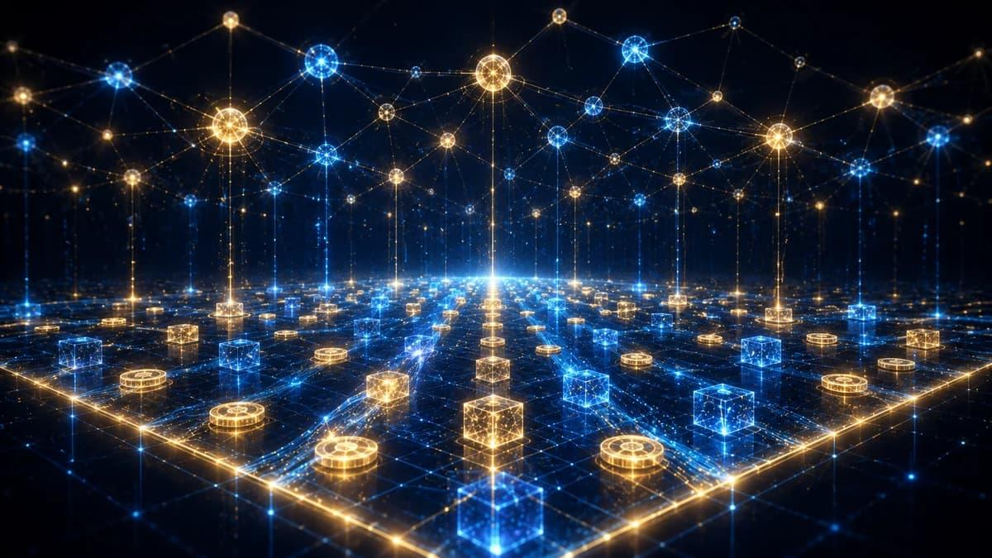
DEX3 Capital Core Contributors Model

Slide 26
Community Hierarchy Model
Proposed Layer | Illustrative Qualifying Volume
Layer 1 | 4,000 USDT
Layer 2 | 2,000 USDT
Layer 3 | 1,000 USDT
Layer 4 | 100 USDT

Slide 27
Genesis Block
1
2
3
4
Layer - 1
Count - 4
Layer - 2
Count - 16
1
2
3
4
5
6
7
8
9
10
11
12
13
14
15
16
Layer – 3 : Count - 64
Layer - 5 : Count - 256
Layer - 6 : Count - 1024
Layer - 7 : Count - 4096
Layer - 8 : Unlimited width
Layer - 9 : Unlimited width

Slide 28
PART-VII
AFFILIATE MARKETING
User, Contributors, Builder & Steward

Slide 29
CONTRIBUTORS
Rank/GCP | Qualification | Allocation | Accumulation
Associate | 24 | 24 | 24
Professional | 72 | 24/Unit | 12/Unit
Expert | 168 | 24/Unit | 12/Unit
Associate
Professional
Expert
D-1
D-2
D-3
D-1
D-2
D-3
D-4
D-5
D-6
D-7

Slide 30
BUILDERS
ELITE
PREMIER
T
D-1
D-2
D-3
Team-20
ELITE-1
E-2
E-3
E-4
E-5
E-6
E-7
E-8
E-9
E-10
E-11
PINNACLE
Rank | GCP Qualification | Contribution Illustration | Maximum Shares
Elite | 480 | Team-20 (+ Direct-3) | 10 Elites
Premier | 5,280 | 11 Elite Partners | 3 Premiers
Pinnacle | 21,120 | 4 Premier Partners | 3 Pinnacles
Premier
1
Premier
2
Premier
3
Premier
4

Slide 31

STEWARDSHIP
STEWARD
PINNACLE
1
PINNACLE
2
PINNACLE
3
PINNACLE
4
Rank | GCP Qualification | Contribution Illustration | Maximum Shares
Steward | 84,480 | 4 Pinnacle Partners | U/L ; 1 line - 1 Steward
STEWARD
Note:
4 Pinnacles in 4 lines = 1 Steward.
1 Steward line+ 3 Pinnacle lines = 1 Steward
2 Steward lines = 2 Stewards.
…..and so on.
This Photo by Unknown Author is licensed under CC BY-NC

Slide 32
ROLE & RANK STRUCTURE
Stage | Community Role | Achievement Rank | Qualification GCP | Allocation GCP | Accumulation GCP
Stage 0 | User | — | — | — | --
Stage 1 | Contributor | Associate | 24 | 24 | 24
 | Contributor | Professional | 72 | 24/Unit | 12/Unit
 | Contributor | Expert | 168 | 24/Unit | 12/Unit
Stage 2 | Builder | Elite Partner | 480 | 24/Unit | 12/Unit
 | Builder | Premier Partner | 5,280 | 480/ Elite | 240/ Elite
 | Builder | Pinnacle Partner | 21,120 | 5,280/ Premier | 2,640/ Premier
Stage 3 | Steward | Steward | 84,480 | 21,120/ Pinnacle | 10,560/ Pinnacle

Slide 33
PART-VIII
DIGITAL MARKETING
Primary Roadmap, Blue print & Summary

Slide 34
Implementation Roadmap
Target date | Milestone
2 Nov 2026 | MVP work and outreach activities start
16 Nov 2026 | SEO, SMO and digital marketing begins
30 Nov 2026 | Landing page and videos targeted
15 Dec 2026 | GRIDZ V-2 readiness/ launch target
31 Dec 2026 | Initial 341-member formation target
31 Jan 2027 | Phase One MVP completion target

Slide 35
BLUE PRINT & FLOWCHART
PoC
DEXDOT
+
DEXTRA
DEXLab
GRIDX
+
DEXFi
PRODUCTION
Unit
GDP
Mining
Profit
Sharing
Rights
GRIDZ
CAPITAL
Resource
Engine
OWNERSHIP
DEX3
Vote
SELLING Platform
Staking/Vesting
Affiliate
system
Hybrid
Governance
Govern
Elite, Premier, Pinnacle & Steward
QDX
Edn
DEXPO
DEXTra
DEXDAO

